Slide 1
Software Testing and Quality Assurance
Theory and Practice
Chapter 5
Data Flow Testing
Notes:
Handouts
------------------------------------------------------------------
------------------------------------------------------------------
-------------------------------------------------------------------
--------------------------------------------------------------------

Slide 2
Outline of the Chapter
The General Idea
Data Flow Anomaly
Overview of Dynamic Data Flow Testing
Data Flow Graph
Data Flow Terms
Data Flow Testing Criteria
Comparison of Data Flow Testing Criteria
Feasible Paths and Test Selection Criteria
Comparison of Testing Techniques
Summary
Notes:
Handouts

Slide 3
The General Idea
A program unit accepts inputs, performs computations, assigns new values to variables, and returns results.
One can visualize of “flow” of data values from one statement to another.
A data value produced in one statement is expected to be used later.
  Example
    Obtain a file pointer ……. use it later.
  If the later use is never verified, we do not know if the earlier assignment is acceptable.
Two motivations of data flow testing
    The memory location for a variable is accessed in a “desirable” way.
    Verify the correctness of data values “defined” (i.e. generated) – observe that all the “uses” of the value produce the desired results.
Idea: A programmer can perform a number of tests on data values.
  These tests are collectively known as data flow testing.
Notes:
Handouts

Slide 4
The General Idea
Data flow testing can be performed at two conceptual levels.
  Static data flow testing
  Dynamic data flow testing
Static data flow testing
  Identify potential defects, commonly known as data flow anomaly.
  Analyze source code.
  Do not execute code.
Dynamic data flow testing
  Involves actual program execution.
  Bears similarity with control flow testing.
    Identify paths to execute them.
    Paths are identified based on data flow testing criteria.
Notes:
Handouts

Slide 5
Data Flow Anomaly
Anomaly: It is an abnormal way of doing something.
  Example 1: The second definition of x overrides the first.
    x = f1(y);
    x = f2(z);
Three types of abnormal situations with using variable.
  Type 1: Defined and then defined again
  Type 2: Undefined but referenced
  Type 3: Defined but not referenced
Notes:
Handouts

Slide 6
Data Flow Anomaly
Type 1: Defined and then defined again (Example 1 above)
  Four interpretations of Example 1
    The first statement is redundant.
    The first statement has a fault -- the intended one might be: w = f1(y).
    The second statement has a fault – the intended one might be: v = f2(z).
    There is a missing statement in between the two: v = f3(x).
  Note: It is for the programmer to make the desired interpretation.
Type 2: Undefined but referenced
  Example: x = x – y – w; /* w has not been defined by the programmer. */
  Two interpretations
    The programmer made a mistake in using w.
    The programmer wants to use the compiler assigned value of w.
Type 3: Defined but not referenced
  Example: Consider x = f(x, y). If x is not used subsequently, we have a Type 3 anomaly.
Notes:
Handouts

Slide 7
Data Flow Anomaly
The concept of a state-transition diagram is used to model a program variable to identify data flow anomaly.
Components of the state-transition diagrams
  The states
    U: Undefined
    D: Defined but not referenced
    R: Defined and referenced
    A: Abnormal
  The actions
    d: define the variable
    r: reference (or, read) the variable
    u: undefine the variable
Notes:
Handouts

Slide 8
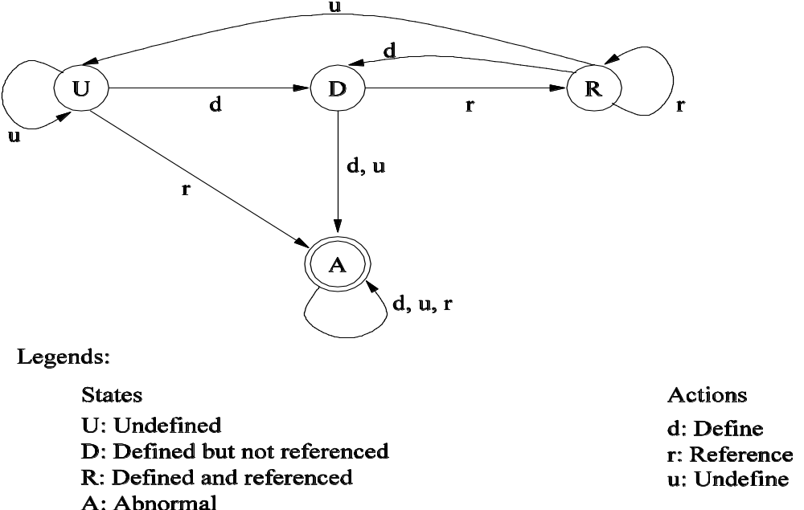
Data Flow Anomaly
  Figure 5.2: State transition diagram of a program variable [10] (©[1979] IEEE).
Notes:
Handouts

Slide 9
Data Flow Anomaly
Obvious question: What is the relationship between the Type 1, Type 2, and Type 3 anomalies and Figure 5.2?
The three types of anomalies (Type 1, Type 2, and Type 3) are found in the diagram in the form of action sequences:
  Type 1: dd
  Type 2: ur
  Type 3: du
Detection of data flow anomaly via program instrumentation
  Program instrumentation: Insert new code to monitor the states of variables.
  If the state sequence contains dd, ur, or du sequence, a data flow anomaly is said to occur.
Bottom line: What to do after detecting a data flow anomaly?
  Investigate the cause of the anomaly.
  To fix an anomaly, write new code or modify the existing code.
Notes:
Handouts

Slide 10
Overview of Dynamic Data Flow Testing
A programmer manipulates/uses variables in several ways.
  Initialization, assignment, using in a computation, using in a condition
Motivation for data flow testing?
  One should not feel confident that a variable has been assigned the correct value, if no test causes the execution of a path from the point of assignment to a point where the value is used.
  Note
    Assignment of correct value means whether or not a value has been correctly generated.
    Use of a variable means
      If new values of the same variable or other variables are generated.
      If the variable is used in a conditional statement to alter the flow of control.
The above motivation indicates that certain kinds of paths are executed in data flow testing.
Notes:
Handouts

Slide 11
Overview of Dynamic Data Flow Testing
Data flow testing is outlined as follows:
  Draw a data flow graph from a program.
  Select one or more data flow testing criteria.
  Identify paths in the data flow graph satisfying the selection criteria.
  Derive path predicate expressions from the selected paths (See Chapter 4.)
  Solve the path predicate expressions to derive test inputs (See Chapter 4.)
Notes:
Handouts

Slide 12
Data Flow Graph
Occurrences of variables
  Definition: A variable gets a new value.
    i = x; /* The variable i gets a new value. */
  Undefinition or kill: This occurs if the value and the location become unbound.
  Use: This occurs when the value is fetched from the memory location of the variable. There are two forms of uses of a variable.
    Computation use (c-use)
      Example: x = 2*y; /* y has been used to compute a value of x. */
    Predicate use (p-use)
      Example: if (y > 100) { …} /* y has been used in a condition. */
Notes:
Handouts

Slide 13
Data Flow Graph
A data flow graph is a directed graph constructed as follows.
  A sequence of definitions and c-uses is associated with each node of the graph.
  A set of p-uses is associated with each edge of the graph.
  The entry node has a definition of each edge parameter and each nonlocal variable used in the program.
  The exit node has an undefinition of each local variable.
Notes:
Handouts

Slide 14
Data Flow Graph
Example code: ReturnAverage() from Chapter 4
public static double ReturnAverage(int value[], int AS, int MIN, int MAX){
/* Function: ReturnAverage Computes the average of all those numbers in the input array in
the positive range [MIN, MAX]. The maximum size of the array is AS. But, the array size
could be smaller than AS in which case the end of input is represented by -999. */
int i, ti, tv, sum;
double av;
i = 0; ti = 0; tv = 0; sum = 0;
while (ti < AS && value[i] != -999) {
ti++;
if (value[i] >= MIN && value[i] <= MAX) {
tv++;
sum = sum + value[i];
}
i++;
}
if (tv > 0)
av = (double)sum/tv;
else
av = (double) -999;
return (av);
}
Figure 4.6: A function to compute the average of selected integers in an array.
Notes:
Handouts

Slide 15
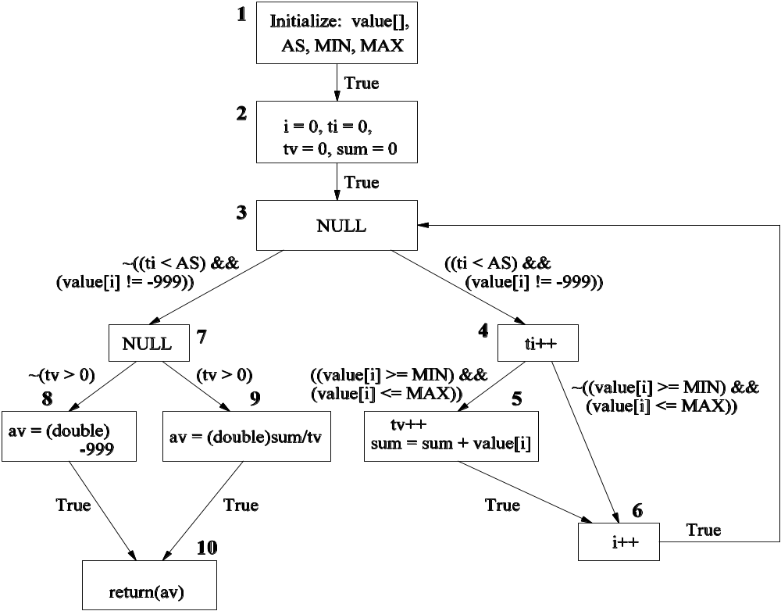
Data Flow Graph
  Figure 5.4: A data flow graph of ReturnAverage() example.
Notes:
Handouts

Slide 16
Data Flow Graph
A data flow graph is a directed graph constructed as follows.
  A sequence of definitions and c-uses is associated with each node of the graph.
  A set of p-uses is associated with each edge of the graph.
  The entry node has a definition of each edge parameter and each nonlocal variable used in the program.
  The exit node has an undefinition of each local variable.
Notes:
Handouts

Slide 17
Data Flow Terms
Global c-use: A c-use of a variable x in node i is said to be a global c-use if x has been defined before in a node other than node i.
  Example: The c-use of variable tv in node 9 (Figure 5.4) is a global c-use.
Definition clear path: A path (i – n₁ – … n_{m} – j), m ≥ 0, is called a definition clear path (def-clear path) with respect to variable x
    from node i to node j, and
    from node i to edge (n_{m}, j),
  if x has been neither defined nor undefined in nodes n₁ – … n_{m}.
  Example: (2 – 3 – 4 – 6 – 3 – 4 – 6 – 3 – 4 – 5) is a def-clear path w.r.t. tv in Fig. 5.4.
  Example: (2 – 3 – 4 – 5) and (2 – 3 – 4 – 6) are def-clear paths w.r.t. variable tv from node 2 to 5 and from node 2 to 6, respectively, in Fig. 5.4.
Notes:
Handouts

Slide 18
Data Flow Terms
Global definition: A node i has a global definition of variable x if node i has a definition of x and there is a def-clear path w.r.t. x from node i to some
    node containing a global c-use, or
    edge containing a p-use of
  variable x.
Simple path: A simple path is a path in which all nodes, except possibly the first and the last, are distinct.
  Example: Paths (2 – 3 – 4 – 5) and (3 – 4 – 6 – 3) are simple paths.
Loop-free paths: A loop-free path is a path in which all nodes are distinct.
Complete path: A complete path is a path from the entry node to the exit node.
Notes:
Handouts

Slide 19
Data Flow Terms
Du-path: A path (n₁ – n₂ – … – n_{j} – n_{k}) is a du-path path w.r.t. variable x if node n₁ has a global definition of x and either
    node n_{k} has a global c-use of x and (n₁ – n₂ – … – n_{j} – n_{k}) is a def-clear simple path w.r.t. x, or
    Edge (n_{j}, n_{k}) has a p-use of x and (n₁ – n₂ – … – n_{j} – n_{k}) is a def-clear, loop-free path w.r.t. x.
  Example: Considering the global definition and global c-use of variable tv in nodes 2 and 5, respectively, (2 – 3 – 4 – 5) is a du-path.
  Example: Considering the global definition and p-use of variable tv in nodes 2 and on edge (7, 9), respectively, (2 – 3 – 7 – 9) is a du-path.
Notes:
Handouts

Slide 20
Data Flow Testing Criteria
Seven data flow testing criteria
  All-defs
  All-c-uses
  All-p-uses
  All-p-uses/some-c-uses
  All-c-uses/some-p-uses
  All-uses
  All-du-paths
Notes:
Handouts

Slide 21
Data Flow Testing Criteria
All-defs
  For each variable x and each node i, such that x has a global definition in node i, select a complete path which includes a def-clear path from node i to
    node j having a global c-use of x, or
    edge (j, k) having a p-use of x.
  Example (partial): Consider tv with its global definition in node 2. Variable tv has a global c-use in node 5, and there is a def-clear path (2 – 3 – 4 – 5) from node 2 to node 5. Choose a complete path (1 – 2 – 3 – 4 – 5 – 6 – 3 – 7 – 9 – 10) that includes the def-clear path (2 – 3 – 4 – 5) to satisfy the all-defs criterion.
Notes:
Handouts

Slide 22
Data Flow Testing Criteria
All-c-uses
  For each variable x and each node i, such that x has a global definition in node i, select complete paths which include def-clear paths from node i to all nodes j such that there is a global c-use of x in j.
  Example (partial): Consider variable ti, which has a global definition in 2 and a global c-use in node 4. From node 2, the def-clear path to 4 is (2 – 3 – 4). One may choose the complete path (1 – 2 – 3 – 4 – 6 – 3 – 7 – 8 – 10). (There three other complete paths.)
All-p-uses
  For each variable x and each node i, such that x has a global definition in node i, select complete paths which include def-clear paths from node i to all edges (j, k) such that there is a p-use of x on (j, k).
  Example (partial): Consider variable tv, which has a global definition in 2 and p-uses on edges (7, 8) and (7, 9). From node 2, there are def-clear paths to (7, 8) and (7, 9), namely (2 – 3 – 7 – 8) and (2 – 3 – 7 – 9). The two complete paths are: (1 – 2 – 3 – 7 – 8 – 10) and (1 – 2 – 3 – 7 – 9 – 10).
Notes:
Handouts

Slide 23
Data Flow Testing Criteria
All-p-uses/some-c-uses
  This criterion is identical to the all-p-uses criterion except when a variable x has no p-use. If x has no p-use, then this criterion reduces to the some-c-uses criterion.
  Some-c-uses: For each variable x and each node i, such that x has a global definition in node i, select complete paths which include def-clear paths from node i to some nodes j such that there is a global c-use of x in j.
  Example (partial): Consider variable i, which has a global definition in 2. There is no p-use of i. Corresponding to the global definition of I in 2, there is a global c-use of I in 6. The def-clear path from node 2 to 6 is (2 – 3 – 4 – 5 – 6). A complete path that includes the above def-clear path is (1 – 2 – 3 – 4 – 5 – 6 – 7 – 9 – 10).
Notes:
Handouts

Slide 24
Data Flow Testing Criteria
All-c-uses/some-p-uses
  This criterion is identical to the all-c-uses criterion except when a variable x has no c-use. If x has no global c-use, then this criterion reduces to the some-p-uses criterion.
  Some-p-uses: For each variable x and each node i, such that x has a global definition in node i, select complete paths which include def-clear paths from node i to some edges (j, k) such that there is a p-use of x on (j, k).
All-uses: This criterion produces a set of paths due to the all-p-uses criterion and the all-c-uses criterion.
All-du-paths: For each variable x and for each node i, such that x has a global definition in node i, select complete paths which include all du-paths from node i
  To all nodes j such that there is a global c-use of x in j, and
  To all edges (j, k) such that there is a p-use of x on (j, k).
Notes:
Handouts

Slide 25
Comparison of Data Flow Testing Criteria
Comparison of two testing criteria c1 and c2
  We need a way to compare the two.
Includes relationship: Given two test selection criteria c₁ and c₂, c₁ includes c₂ if for every def/use graph, any set of complete paths of the graph that satisfies c₁ also satisfies c₂.
Strictly includes relationship: Given two test selection criteria c₁ and c₂, c₁ strictly includes c₂ provided c₁ includes c₂ and for some def/use graph, there is a set of complete paths of the graph that satisfies c₂ but not c₁.
Notes:
Handouts

Slide 26
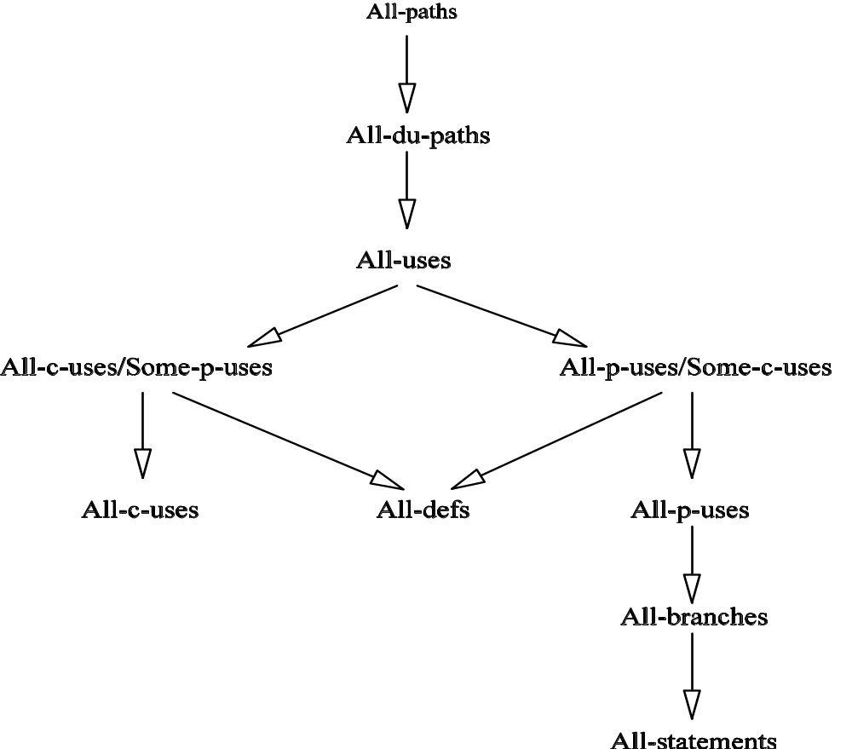
Comparison of Data Flow Testing Criteria
Figure 5.5: The relationship among DF (data flow) testing criteria [6] (©[1988] IEEE).
Notes:
Handouts

Slide 27
Feasible Paths and Test Selection Criteria
Executable (feasible) path
  A complete path is executable if there exists an assignment of values to input variables and global variables such that all the path predicates evaluate to true.
Consideing the feasibility of paths, the “includes” relatipnships of Fig. 5.5 change to Fig. 5.6.
Notes:
Handouts

Slide 28
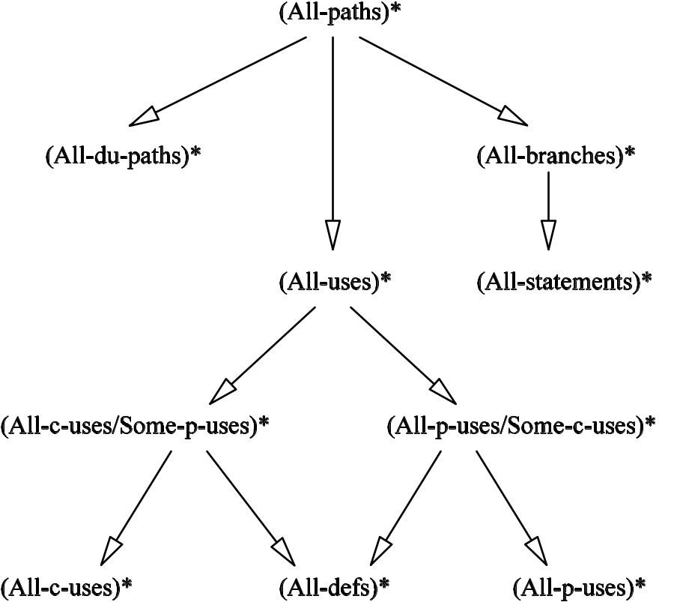
Comparison of Testing Techniques
Figure 5.6: The relationship among the FDF (feasible data flow) testing criteria [6] (©[1988] IEEE).
Notes:
Handouts

Slide 29
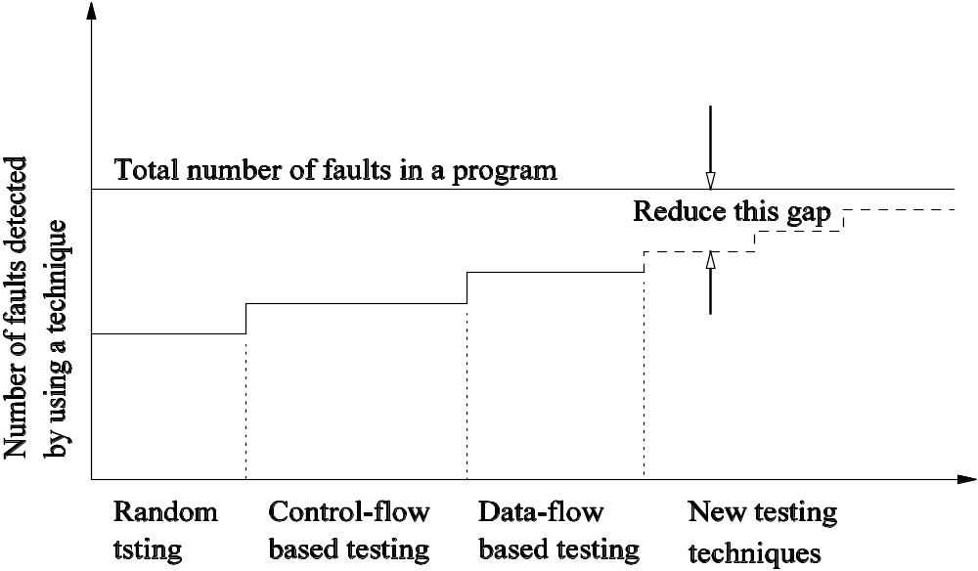
Comparison of Testing Techniques
Figure 5.7: Limitations of different fault detection techniques.
Notes:
Handouts

Slide 30
Summary
Data flow is a readily identifiable concept in a program unit.
Data flow testing
  Static
  Dynamic
Static data flow analysis
  Data flow anomaly can occur due to programming errors.
  Three types of data flow anomalies
    (Type 1: dd), (Type 2: ur), (Type 3, du)
    Analyze the code to identify and remove data flow anomalies.
Dynamic data flow analysis
  Obtain a data flow graph from a program unit.
  Select paths based on DF criteria: all-defs, all-c-uses, all-p-uses, all-uses, all-c-uses/some-p-uses, all-p-uses/some-c-uses, all-du-paths.
  The includes relationship is useful in comparing selection criteria.
Notes:
Handouts

